Slide 1
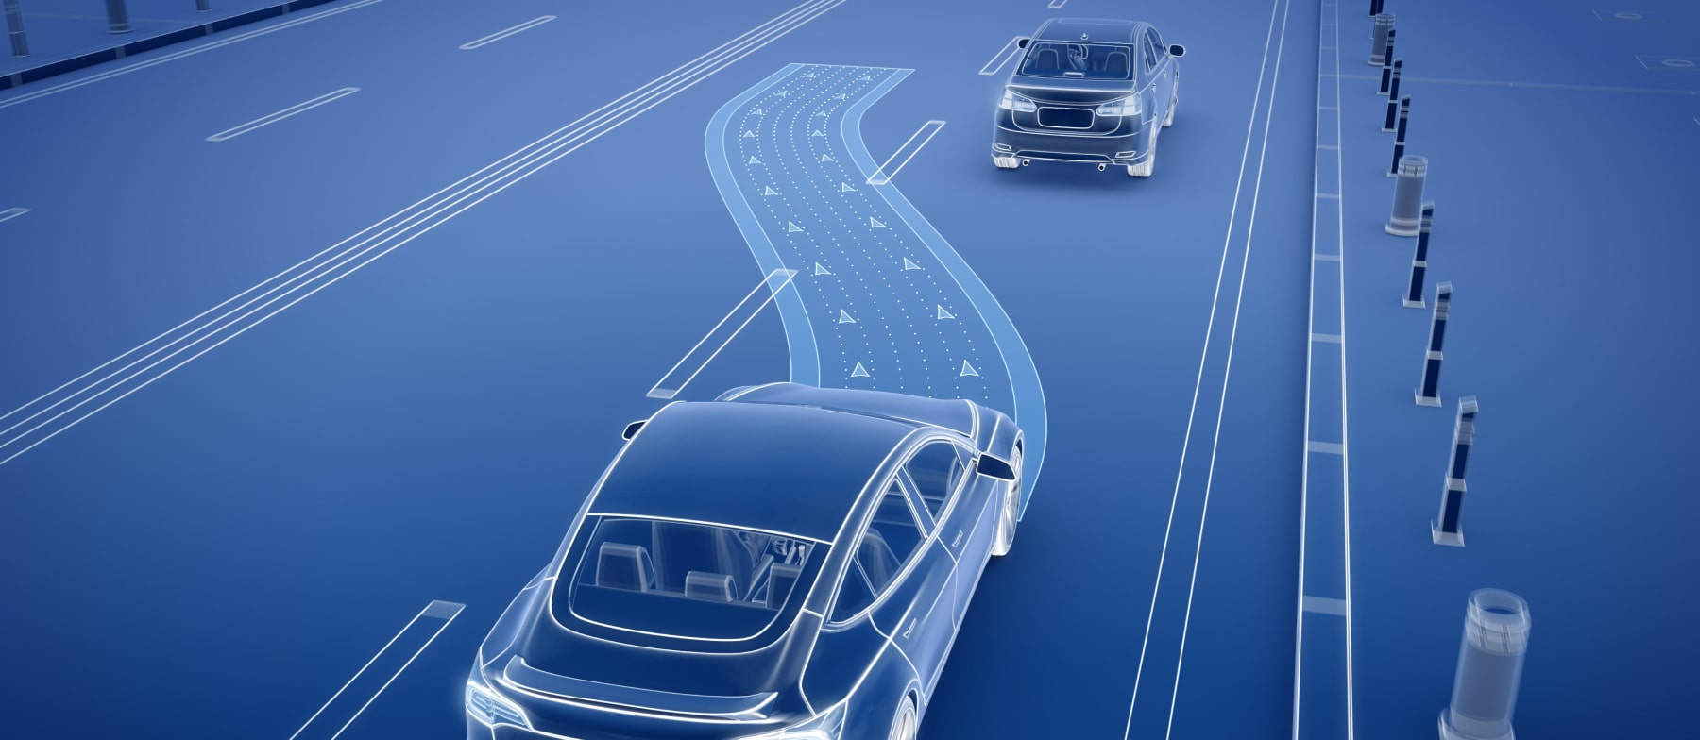
Deep Reinforcement Learning for Decision Making in Autonomous Driving
Amey Deshpande
Bhushan Rane
Denny Boby
Yash Patil

Slide 2
Introduction
Autonomous Driving is a promising technology to enhance road safety, ease road congestion, decrease fuel consumption, and free human driving.
Perception
Prediction
Decision Making
Planning
Control

Slide 3
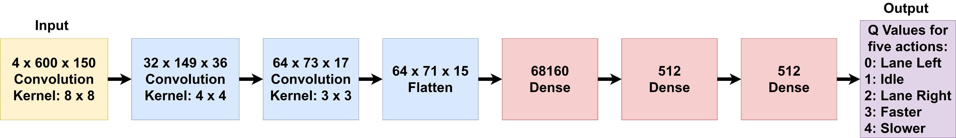
Methodology
Deep Q-Network (DQN)

Slide 4
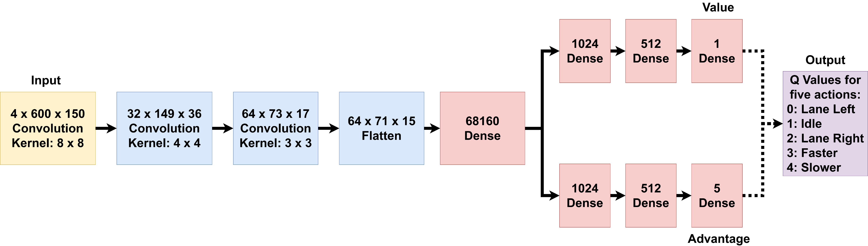
Methodology
Dueling Double Deep Q-Network (DDDQN)

Slide 5
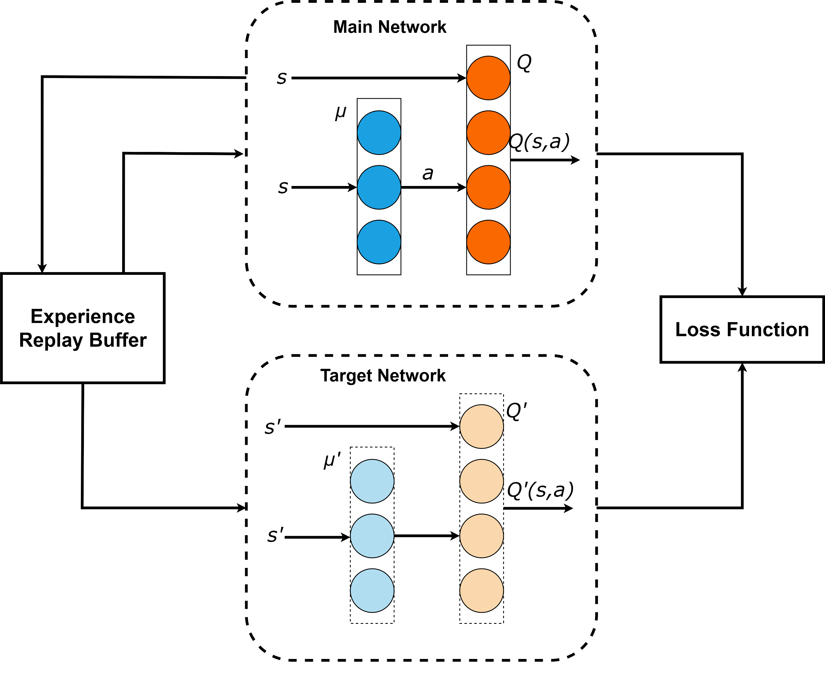
Methodology
Deep Deterministic Policy Gradient (DDPG)

Slide 6
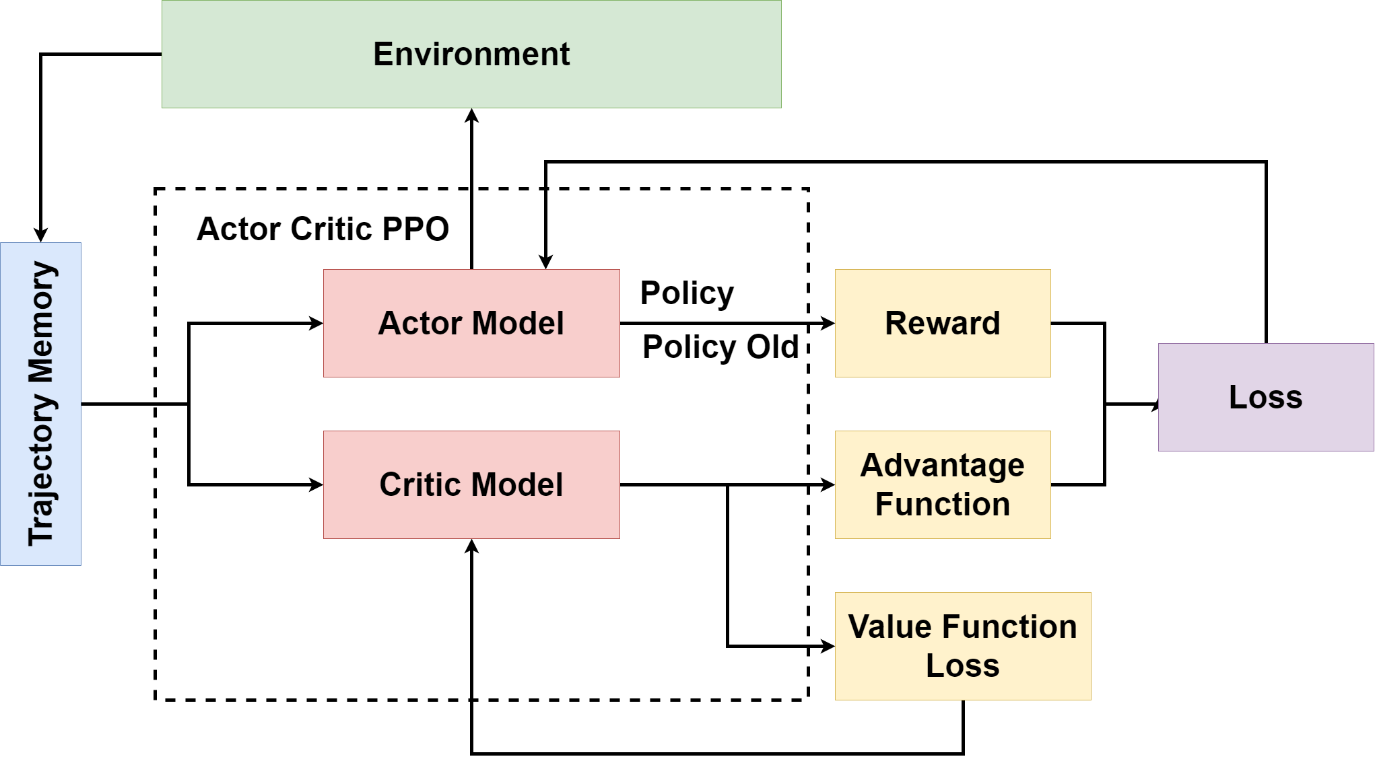
Methodology
Proximal Policy Optimization (PPO)

Slide 7
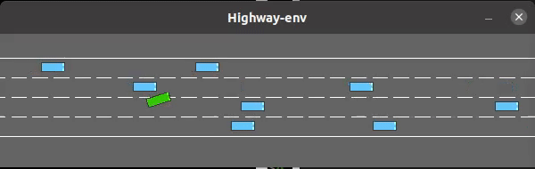
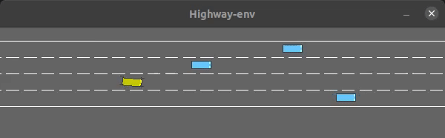
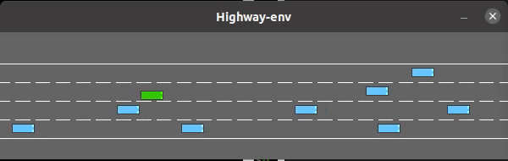
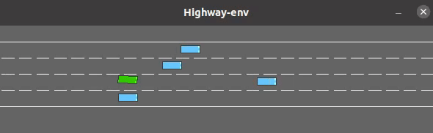
Videos
DQN
DDPG
DDDQN
PPO

Slide 8
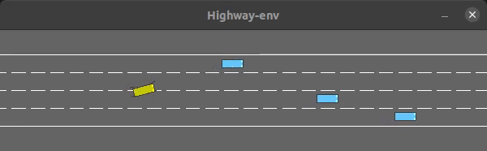
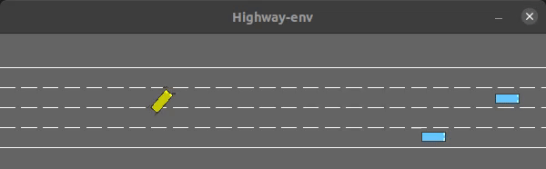
Break The Game
Things always don’t go as planned, we were on time crunch and agent had other plans:

Slide 9
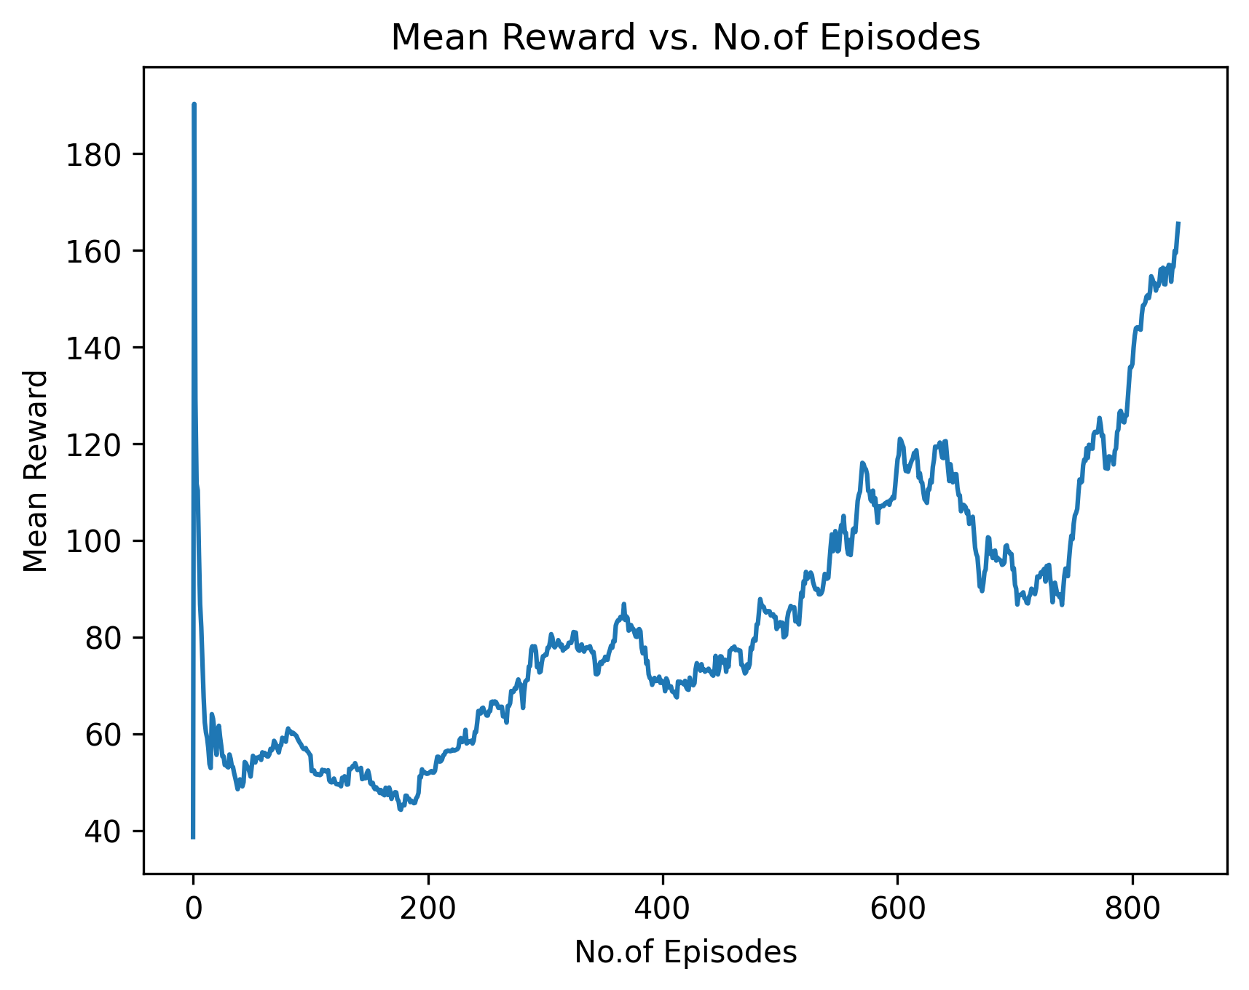
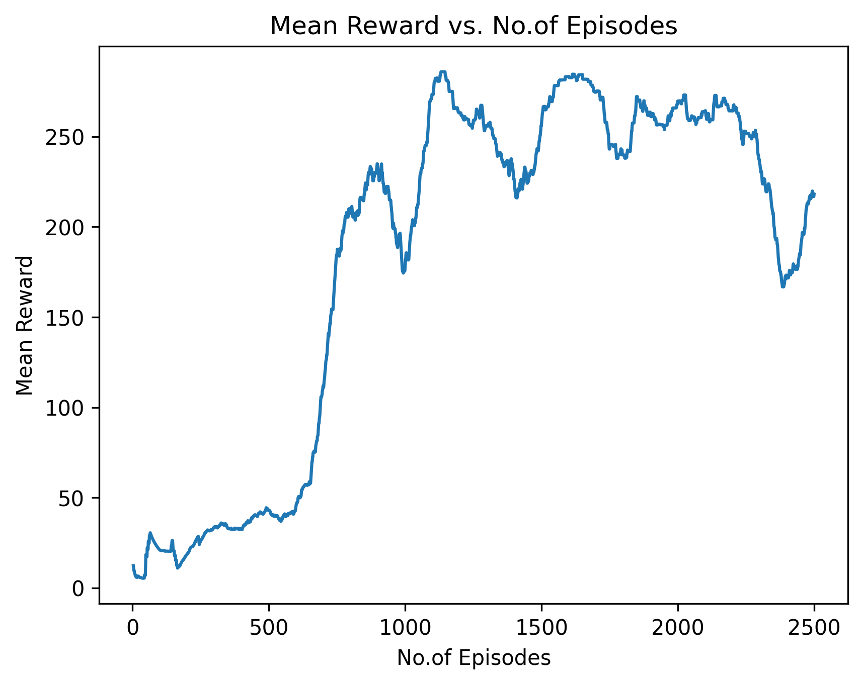
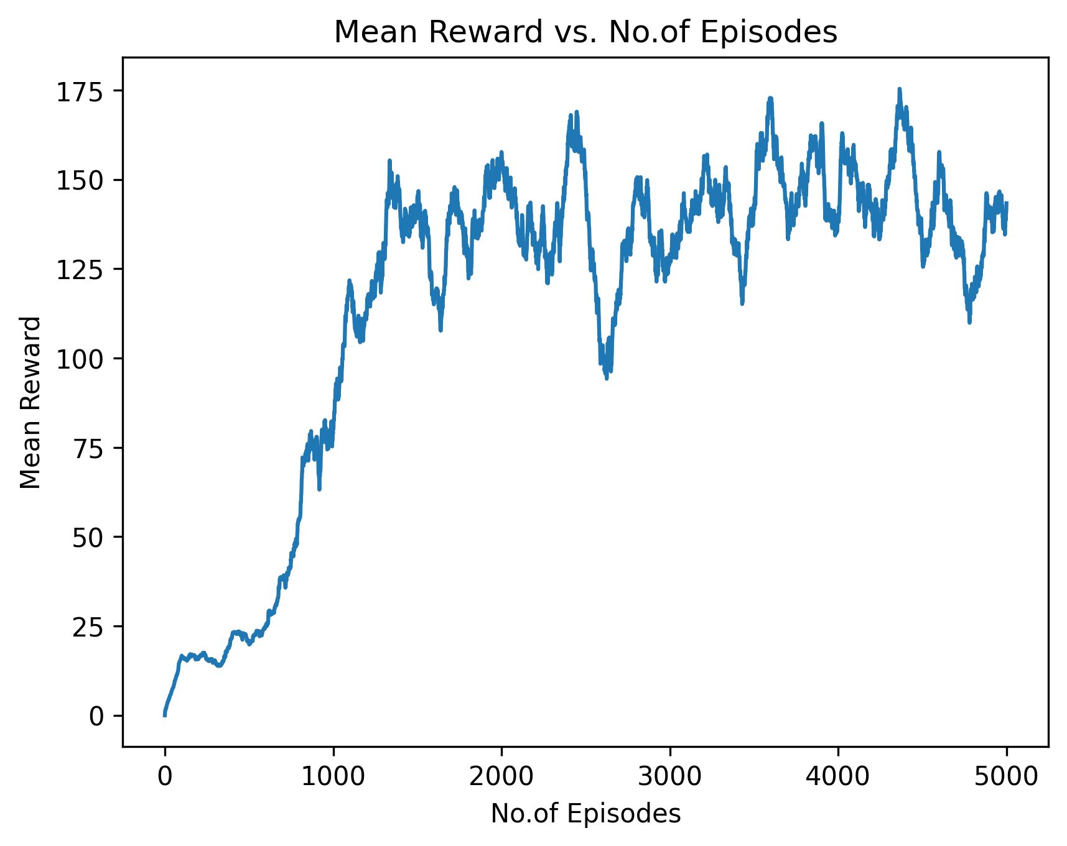
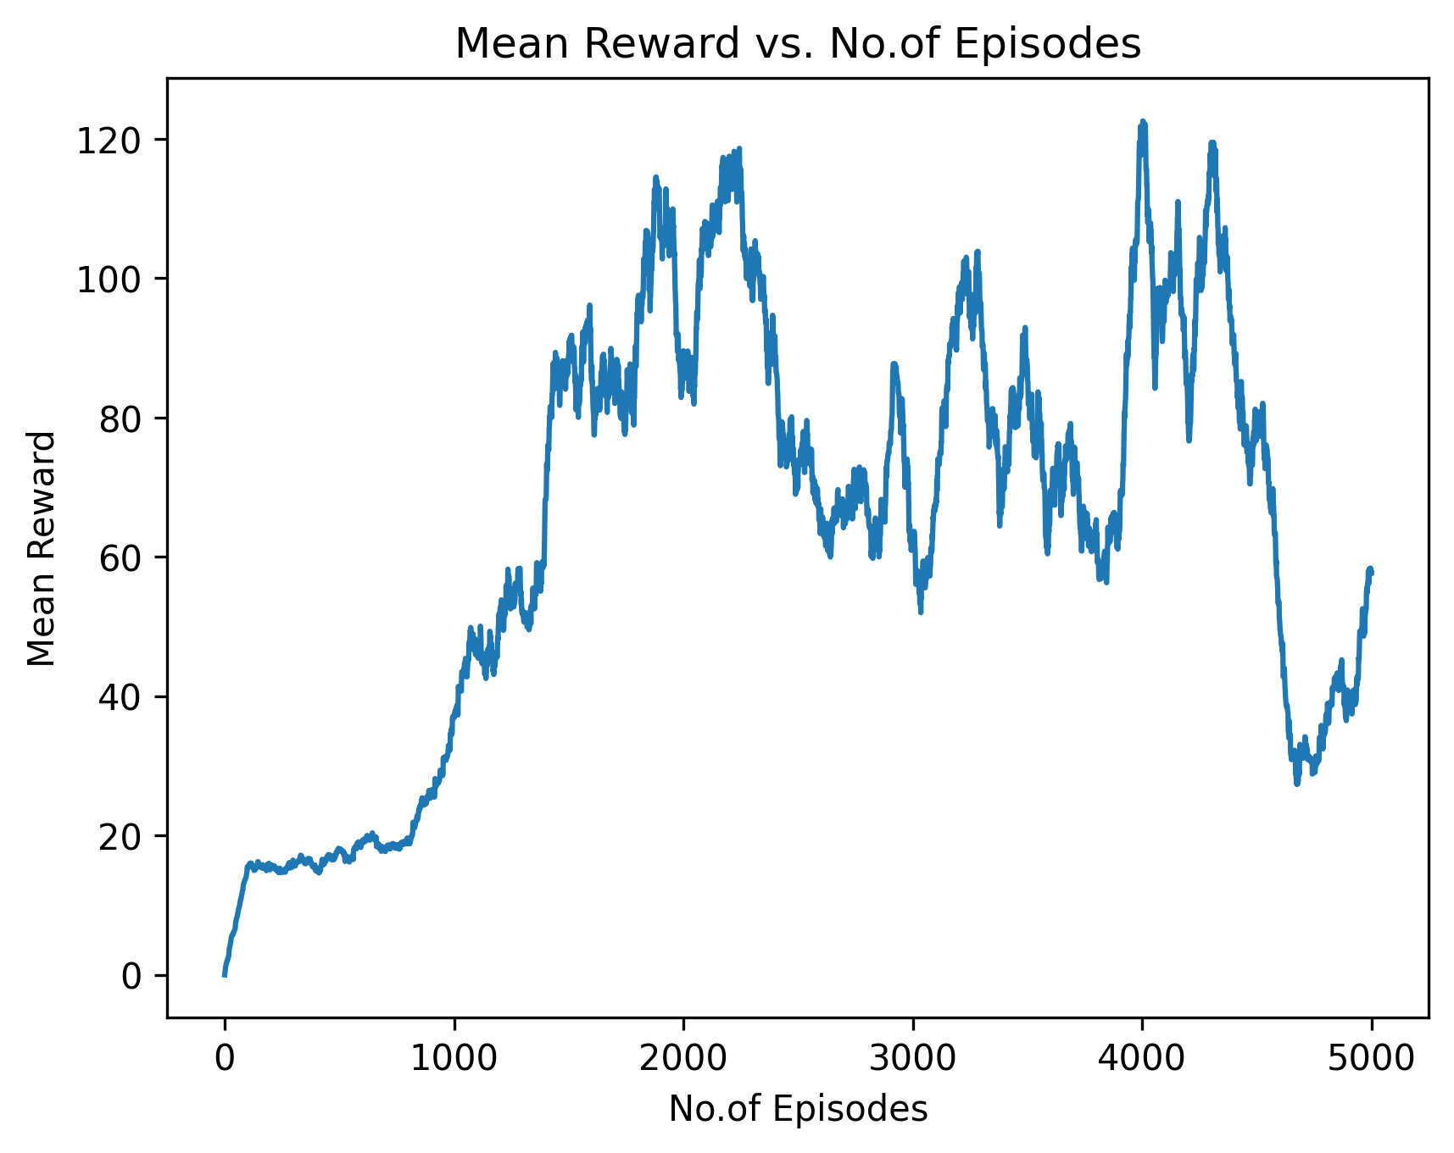
Results
PPO
DDPG
DDDQN
DQN

Slide 10
Conclusion
We can see from the results that DQN learned at 2000 episodes and had a mean score of 90 after it learned. While DDDQN learned at 1300 episodes and had a mean score of 130.
This aligns with the hypothesis that DDDQN is an improvement over DQN.
DDPG was trained on continuous action-space so it took time for the agent to follow the lane.
DDPG learned at 1200 episodes and had a mean score of 230 but we can't compare it with other algorithms because it was trained on continuous action space.
PPO learned at 800 episodes and had a mean score of 180 which is much higher than DQN and DDDQN.

Slide 11
THANK YOU !

